Slide 1
Access Tables

Slide 2
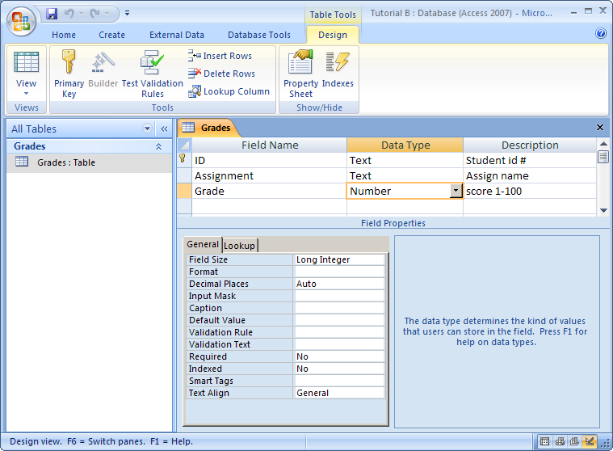
Tables are created in Design View
Click the Data Type list arrow to see a list of types to select from. A field description is optional, but it is a good idea to supply one.
Enter a field name that describes the purpose of the field.
Other field properties can be set in the Properties window.

Slide 3
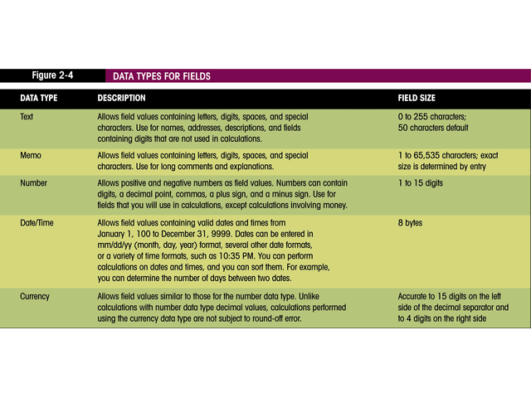
Access field types

Slide 4
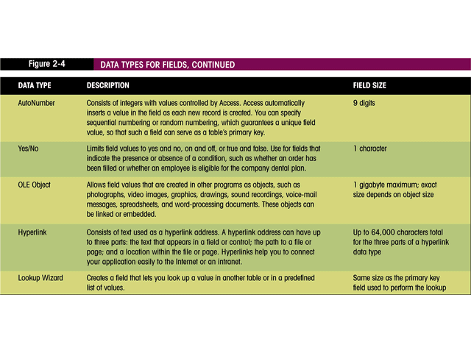
Access field types (continued)

Slide 5
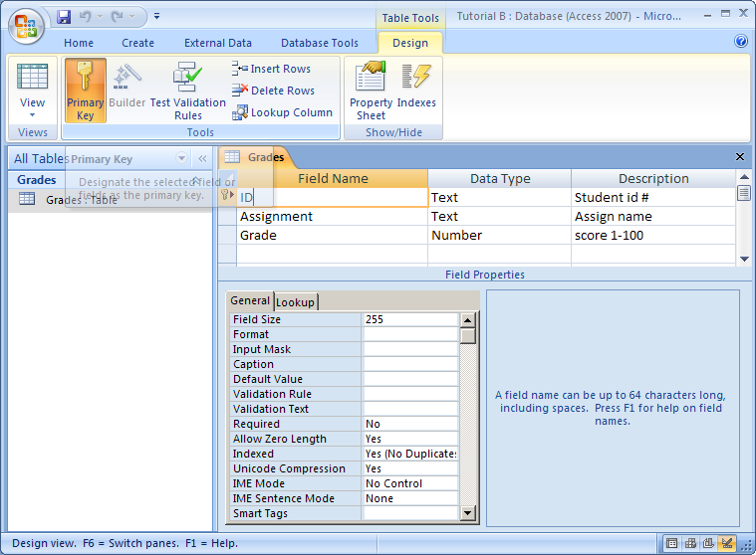
Choosing a primary key
Click a row selector for the field you want to use as the primary key, and then click the Primary Key button on the toolbar.
After clicking the Primary Key button, a key symbol appears in the row selector to indicate the key field.

Slide 6
END

